Slide 1

Autonomous Vehicle Navigation Using Computer Vision and Deep Learning

Slide 2

Introduction
Autonomous Vehicle Navigation Using Computer Vision and Deep Learning
Enhancing Road Safety and Automation
Team Members:
Vivek Kumar (106121146)
Kethavath Murali (106121062)

Slide 3
Problem Statement
Accurate lane detection
Real-time decision making
Motor control integration
Environmental adaptability

Slide 4

Technology Stack
Raspberry Pi 4
Camera module
Arduino with motor control
OpenCV for image processing
Deep learning models for lane detection
C++ programming for system integration

Slide 5
System Architecture
Camera for image capture
Raspberry Pi for image processing and decision making
Arduino for motor control

Slide 6
Communication
OpenCV for data processing
Serial communication between Raspberry Pi and Arduino

Slide 7
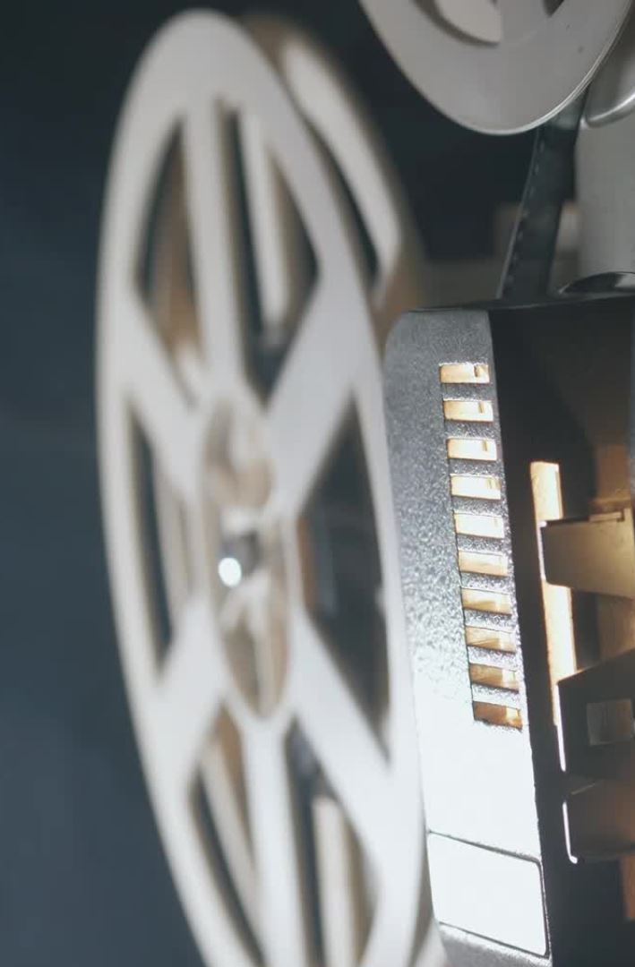
Workflow
Camera captures video frames
OpenCV processes frames for lane detection
Deep learning algorithms analyze lane positions
Decision-making module sends motor control commands to Arduino
Arduino executes motor control based on commands

Slide 8
Code Overview
Perspective transformation
Thresholding and edge detection
Histogram analysis for lane detection
Motor Control Commands
Forward, backward, left, right, U-turn
Lane center calculation for lateral contron

Slide 9
Results
Accurate lane positioning in varying conditions
Smooth navigation based on lane analysis
Real-time processing with high FPS

Slide 10
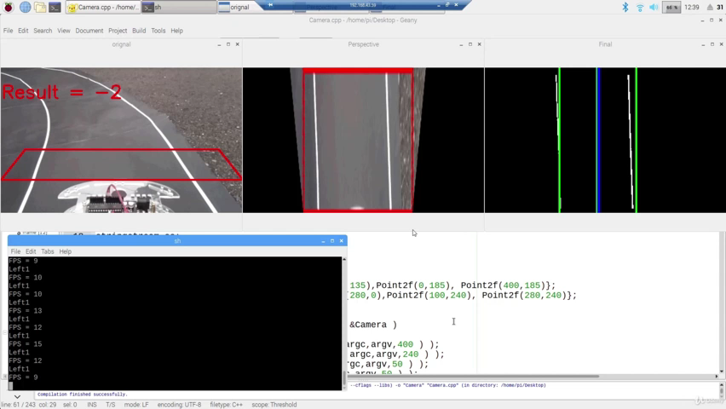

Slide 11
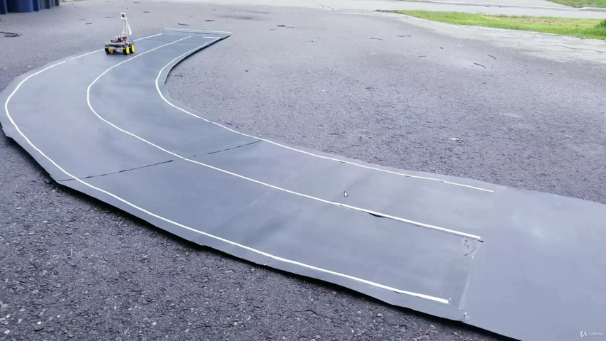

Slide 12
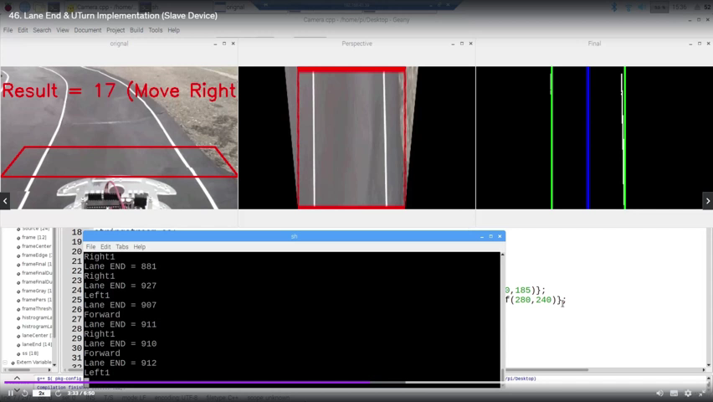

Slide 13
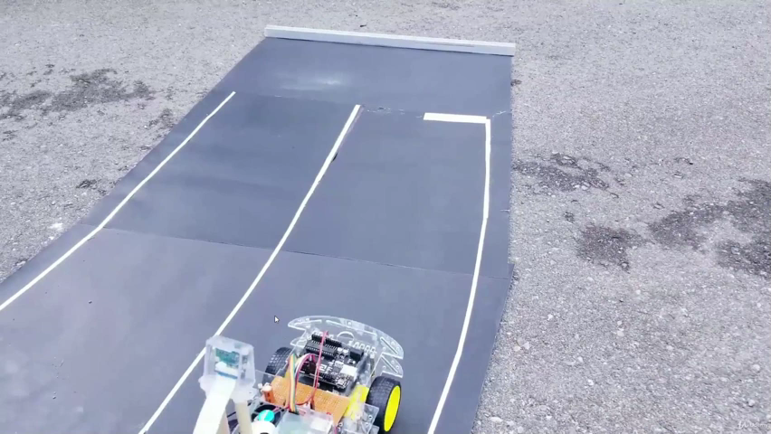

Slide 14
Future Scope
Lane curvature detection
Road sign recognition
Ultrasonic sensors for obstacle detection
GPS for navigation and mapping
Reinforcement learning for adaptive navigation
Neural network optimization for speed and efficiency

Slide 15
Conclusion
Successful implementation of autonomous navigation
Integration of computer vision and motor control
Enhance detection capabilities and decision making
Expand functionality with additional sensors and AI techniques

Slide 16

Thank You

